Slide 1
FOOD COURT An Ecommerce Website
Gautami Mehta

Slide 2
Food Court - Overview
Food Court is an Ecommerce Website built using the following
Front-End - Angular – A free open source web application framework.
Back-End - Node Js – An opensource, backend JavaScript environment.
MongoDB – A source available for database program.
Postman – Used for API testing.

Slide 3
Technology Stack & Versions
Technology | Versions
angular/cli | 13.1.3
node | 17.3.1
mongoose | 6.1.10
express | 4.17.2
jsonwebtoken | 8.5.1
bootstrap | 5.1.3

Slide 4
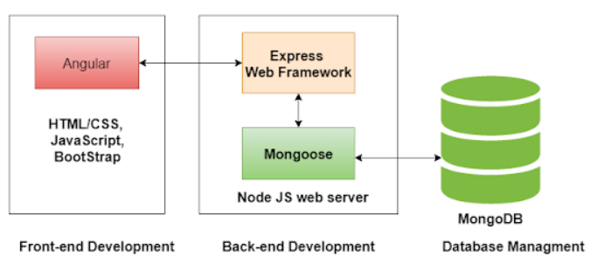
End to End Diagram

Slide 5
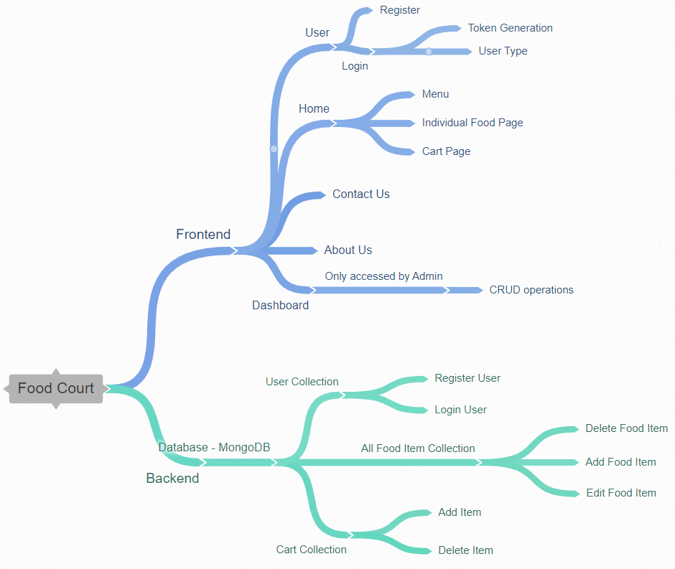
Flow Diagram

Slide 6
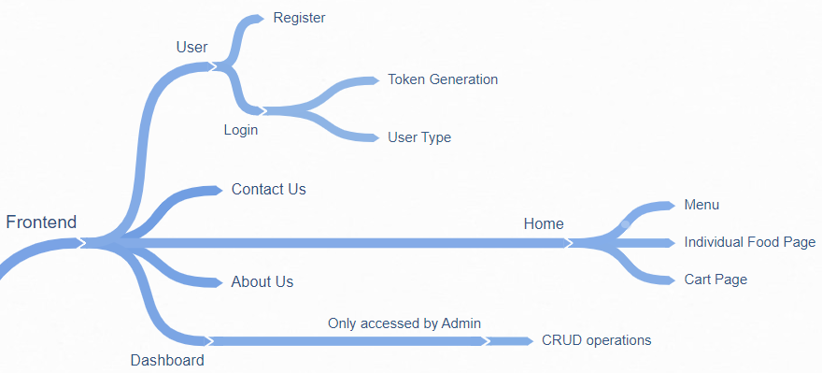
Frontend

Slide 7
Modules Imported for Frontend
Modules Imported | Usage
HttpClientModule | Fetches data from backend
ReactiveFormsModule | access to information about a given control instance
AuthService | Provides Authentication
FontAwesomeModule | Usage of Font Awesome Icons
MatTableModule | Store data in proper table format
JwtHelperService | attaches a JSON Web Token to HttpClient requests
NgModule | Configures the compiler and functionality

Slide 8
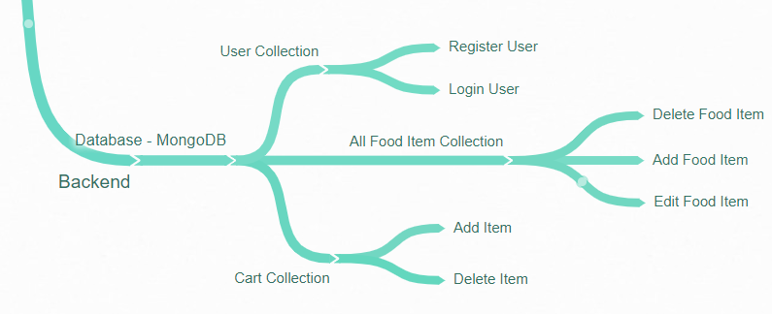
Backend

Slide 9
Frameworks for Backend
Frameworks Imported | Usage
Express | Application framework for Node.js designed for building web applications and APIs.
Mongoose | A JavaScript library that creates a connection between MongoDB and Express.
Cors | Cross-origin resource sharing - allows restricted resources on a web page to be requested from another outside domain.
Dotenv | module that loads environment variables from a .env file into process. env - separate secrets from your source code

Slide 10
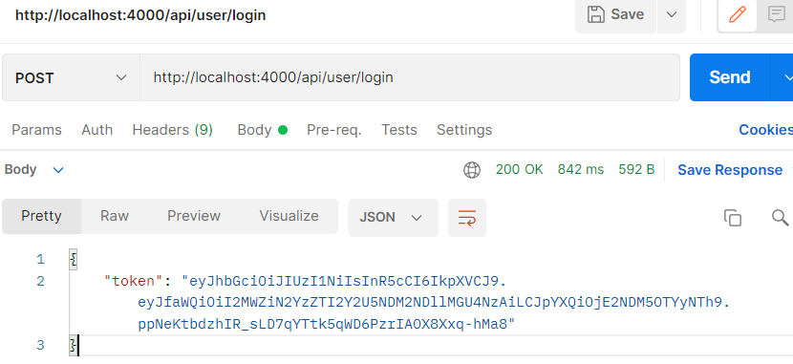
Postman - Testing of API
Token Generation

Slide 11
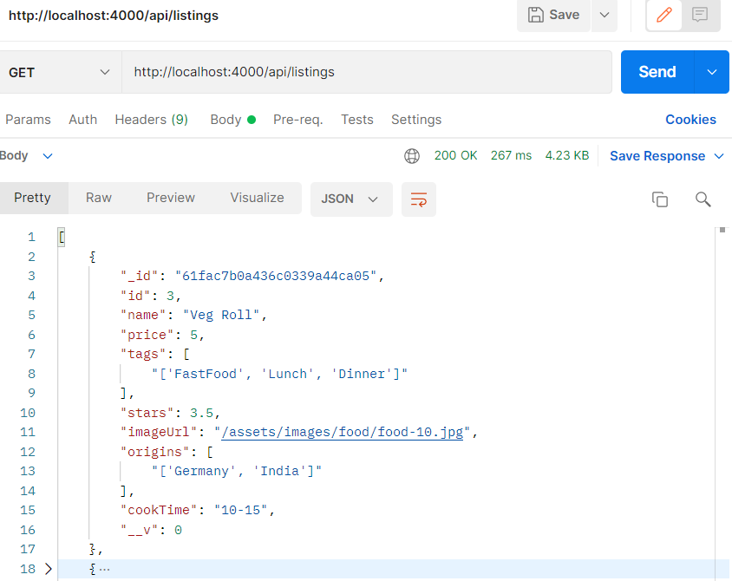
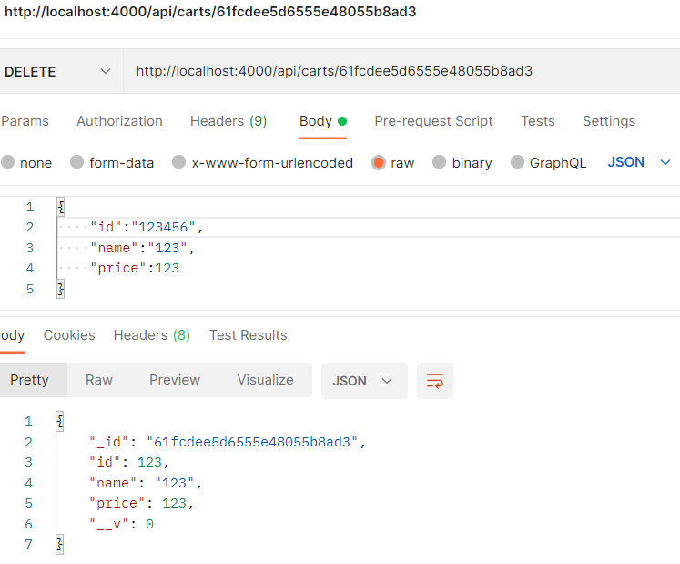

Slide 12
Challenges Faced During Application Development
Choosing the appropriate Technology Stack
Web Security – Authorization and Authentication
Token Generation
Using Tables with Angular materials
Observables and their usage.

Slide 13
Learning Outcome
The Angular CLI
Authorization and Authentication - Role based Access Control
Token Generation
Use of local storage and session storage
Connection of MongoDB using Node.js
Postman and API Testing

Slide 14
THANK YOU

